Slide 1
DS4023（2025 Fall） Machine Learning Department of Computer Science Beijing Normal-Hong Kong Baptist University

Slide 2
Chapter 2: Statistical Learning

Slide 3

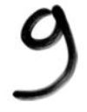
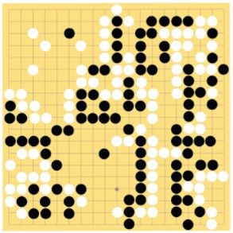
Machine Learning ≈ Construct a mapping function (rule)
Speech recognition
Image recognition
围棋
Machine Translation
“你好”
“9”
“6-5”
(落子位置)
“你好！”
“Hello!”

Slide 4
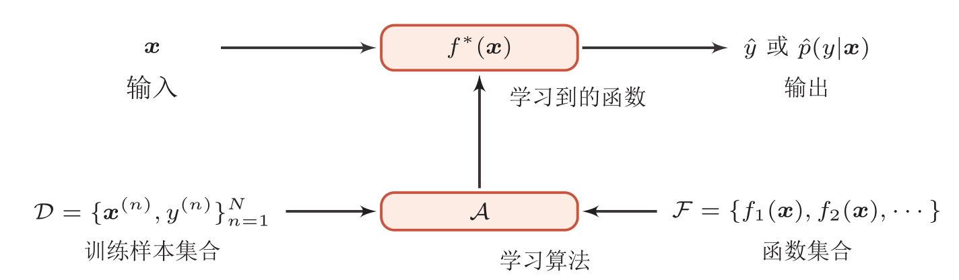
Definition of ML
ML: through algorithms, machines can learn rules from a large number of data and make decisions on new sample
Rules: decision (prediction) function
测试集
Input
Output
训练集
Different ML model
Independent and Identical distribution p(x,y)

Slide 5
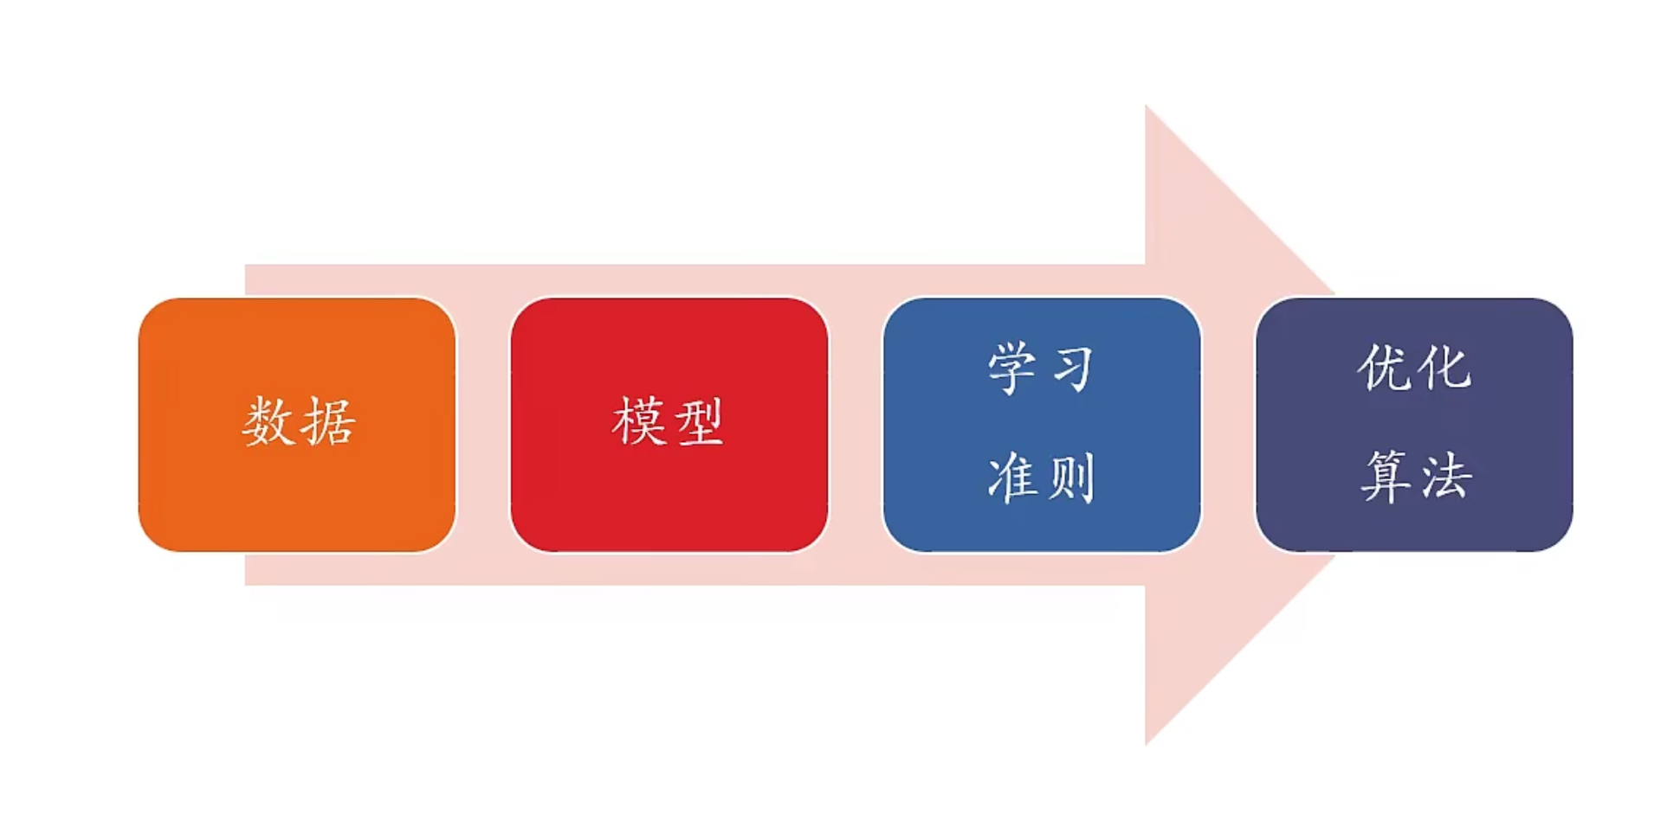
Four Elements in Machine Learning
Data
Model
Learning Rule
Optimization
Algorithm

Slide 6
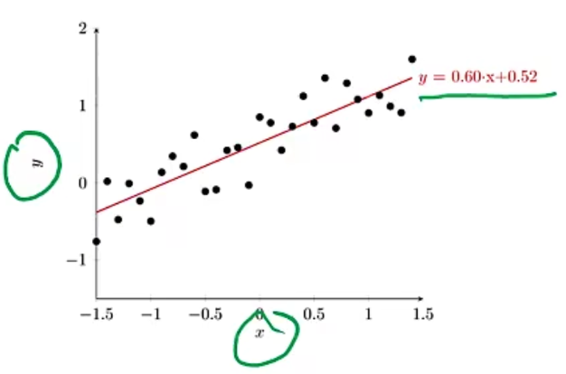
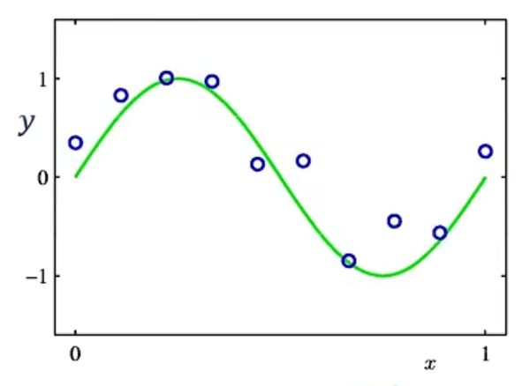
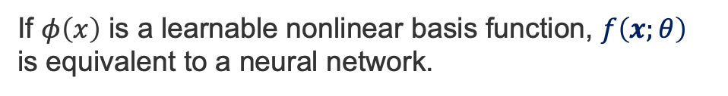
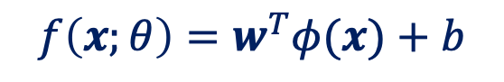
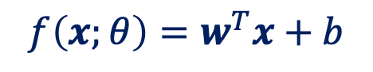
Model
Taking regression as an example
Linear Model
Nonlinear Model
$$f\left(x;θ\right)=w^{T}x+b$$
$$f\left(x;θ\right)=w^{T}φ(x)+b$$
If $φ\left(x\right)$ is a learnable nonlinear basis function, $f\left(x;θ\right)$ is equivalent to a neural network.

Slide 7
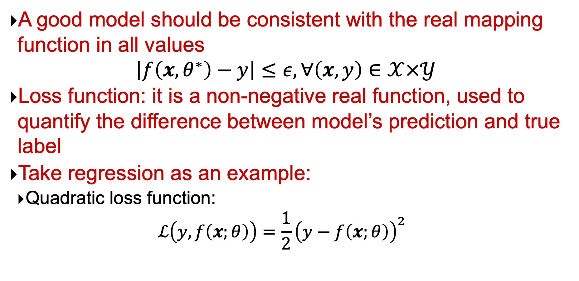
Learning Rules
A good model should be consistent with the real mapping function in all values
$$\left|f\left(x,θ^{∗}\right)−y\right|≤ε, ∀\left(x,y\right)∈𝒳×𝒴$$
Loss function: it is a non-negative real function, used to quantify the difference between model’s prediction and true label
Take regression as an example:
Quadratic loss function:
$$ℒ\left(y,f\left(x;θ\right)\right)=\frac{1}{2}{\left(y−f\left(x;θ\right)\right)}^{2}$$

Slide 8
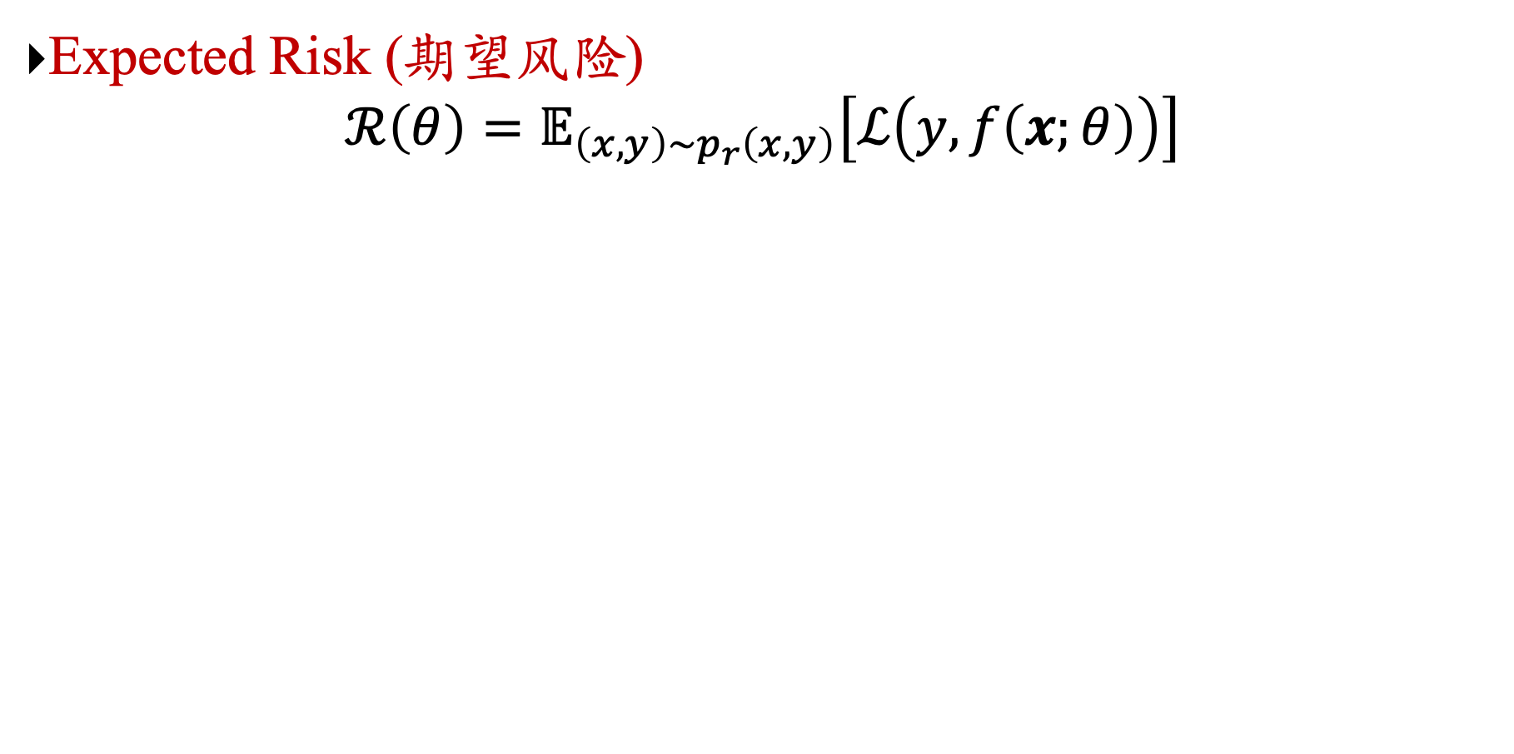
Learning Rules
Expected Risk (期望风险)
$$ℛ\left(θ\right)=𝔼_{\left(x,y\right)∼p_{r}\left(x,y\right)}\left[ℒ\left(y,f\left(x;θ\right)\right)\right]$$
Real data distribution
Loss function
Notes:
最小化期望风险
大数定律，期望通过采样的方法来近似。
采样，样本构成训练集

Slide 9
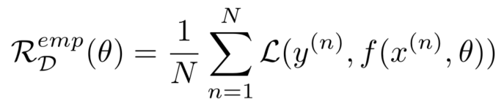
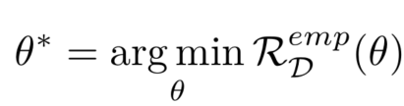
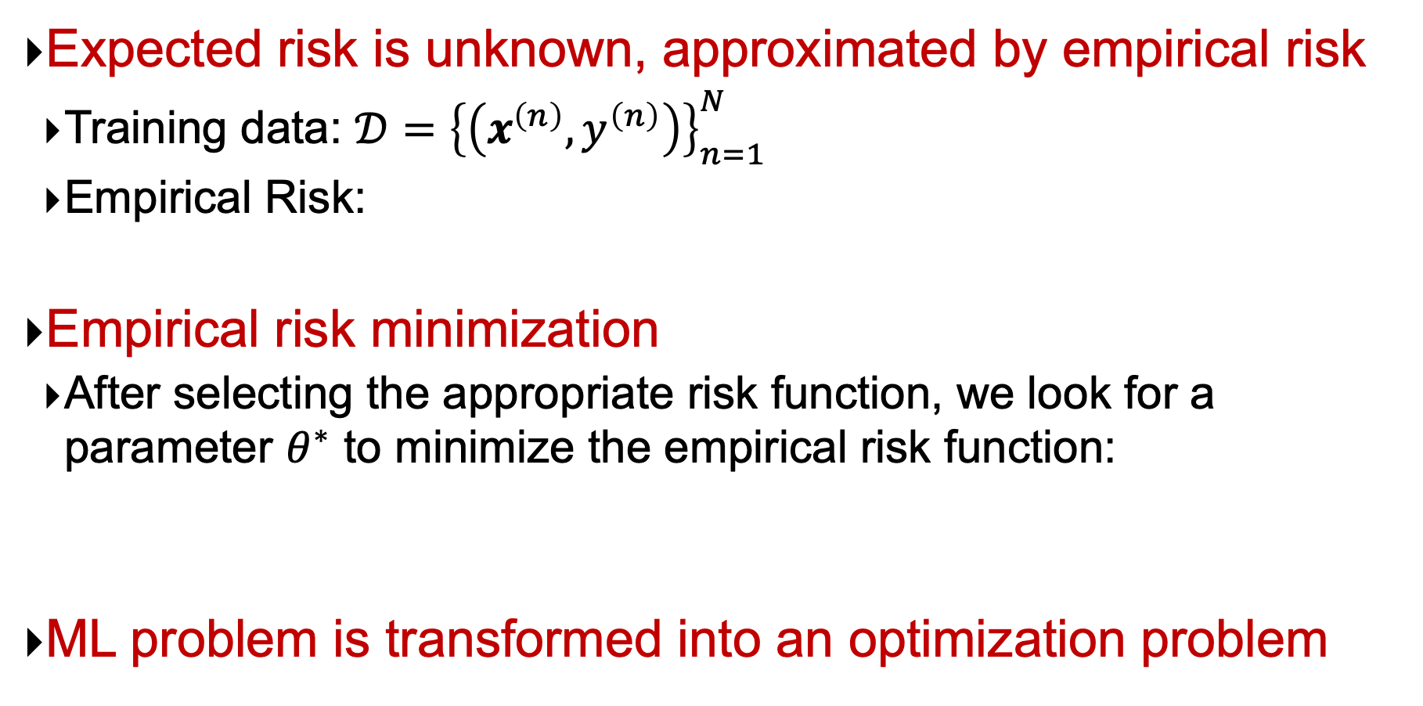
Learning Rules
Expected risk is unknown, approximated by empirical risk
Training data: $𝒟={\left\{\left(x^{\left(n\right)},y^{\left(n\right)}\right)\right\}}_{n=1}^{N}$
Empirical Risk:
Empirical risk minimization
After selecting the appropriate risk function, we look for a parameter $θ^{∗}$ to minimize the empirical risk function:
ML problem is transformed into an optimization problem

Slide 10
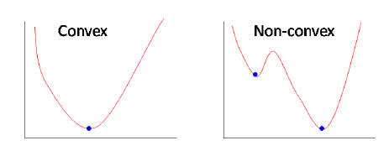
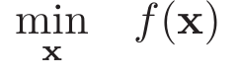
Optimization Problems
ML problems are transformed into optimization problems
Notes:
二阶导数大于0

Slide 11
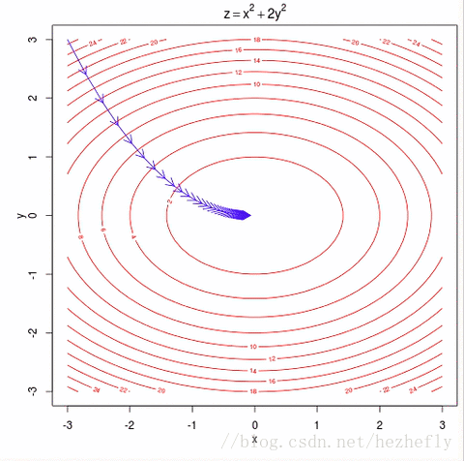
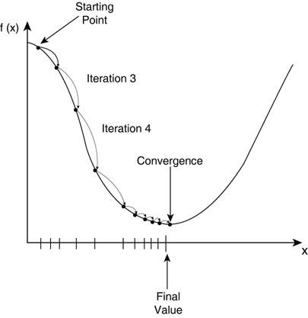
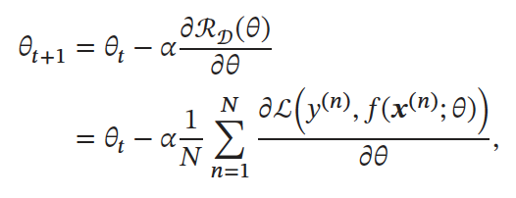
Gradient Descent (梯度下降法)
The search step size $α$ is also called Learning Rate

Slide 12


Learning rate is a very important Hyperparameter!

Slide 13
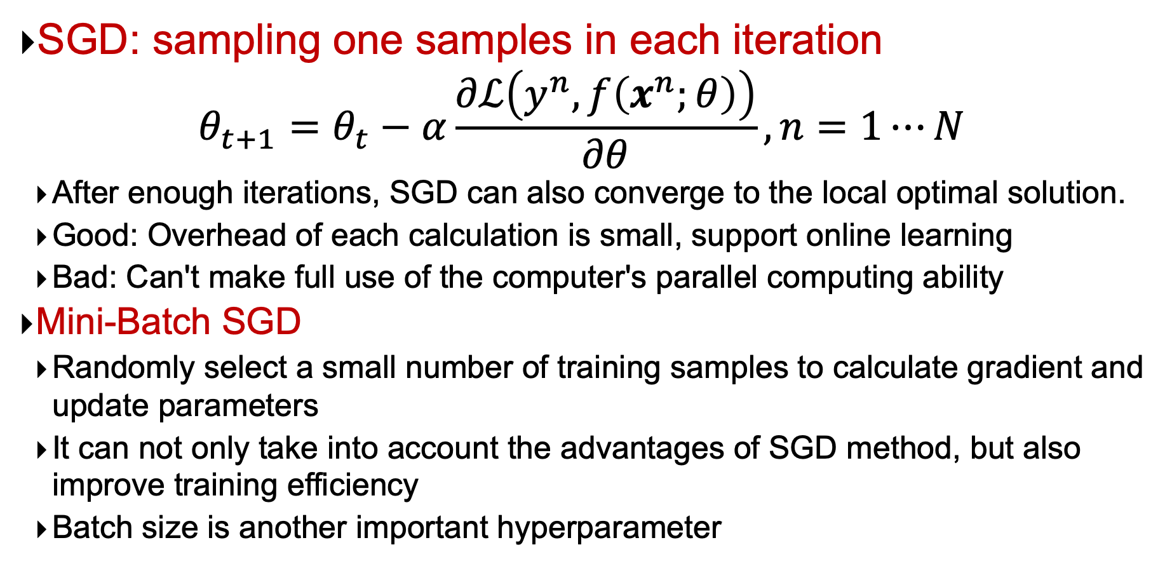
Stochastic Gradient Descent (SGD, 随机梯度下降法）
SGD: sampling one samples in each iteration
$$θ_{t+1}=θ_{t}−α\frac{∂ℒ\left(y^{n},f\left(x^{n};θ\right)\right)}{∂θ}, n=1⋯N$$
After enough iterations, SGD can also converge to the local optimal solution.
Good: Overhead of each calculation is small, support online learning
Bad: Can't make full use of the computer's parallel computing ability
Mini-Batch SGD
Randomly select a small number of training samples to calculate gradient and update parameters
It can not only take into account the advantages of SGD method, but also improve training efficiency
Batch size is another important hyperparameter

Slide 14
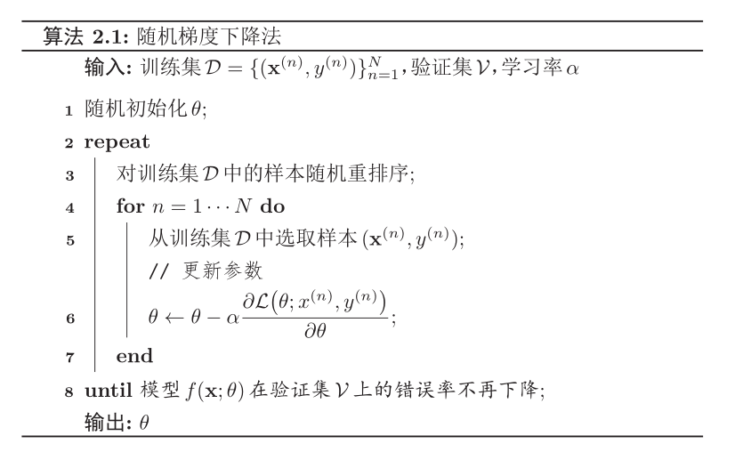
Stochastic Gradient Descent
Why?
Notes:
无法判断是否收敛，仅凭单个样本的表现

Slide 15
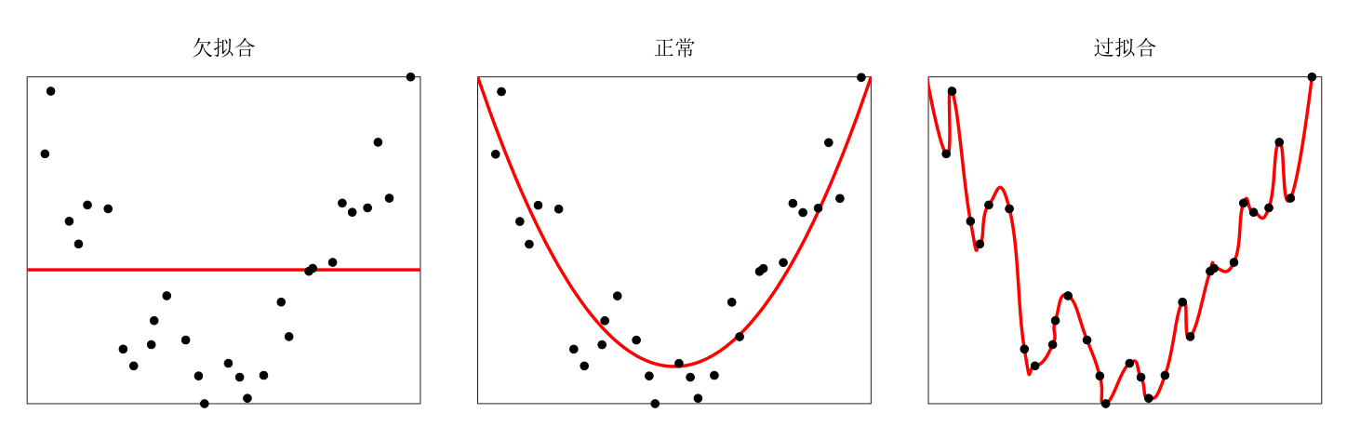
Machine Learning = Optimization?
NO！
ML = Optimization？
Underfitting
Good
Overfitting
Overfitting: the principle of empirical risk minimization can easily lead to a low error rate in the training set, but a high error rate in the unknown data.
Overfitting problems are often caused by less training data and noise.

Slide 16
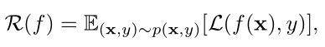
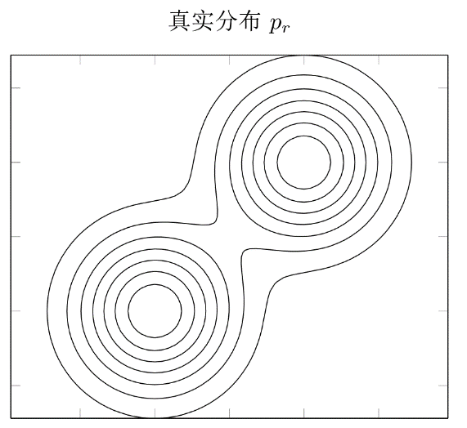
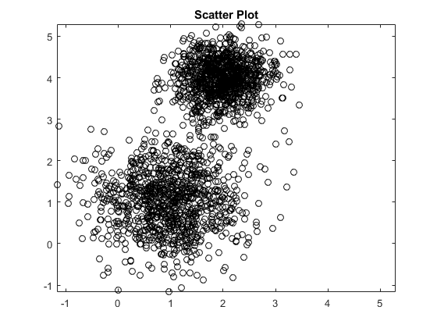
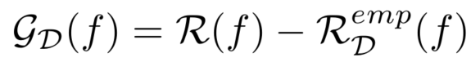

Generalization Error (泛化误差)
Expected Risk
Empirical Risk
$$≠$$
Generalization error
Notes:
泛化错误可以衡量一个机器学习模型是否可以很好地泛化到未知数据。机器学习的目标是减少泛化错误。%泛化错误一般表现为一个模型在训练集和测试集上错误率的。
过拟合：经验风险很低，但是期望风险高。
我们希望经验风险和泛化误差都低。

Slide 17

How to reduce generalization errors?
Optimization: minimize empirical Risk
Regularization (正则化): Reduce model complexity
Notes:
L1/L2正则化
Dropout

Slide 18
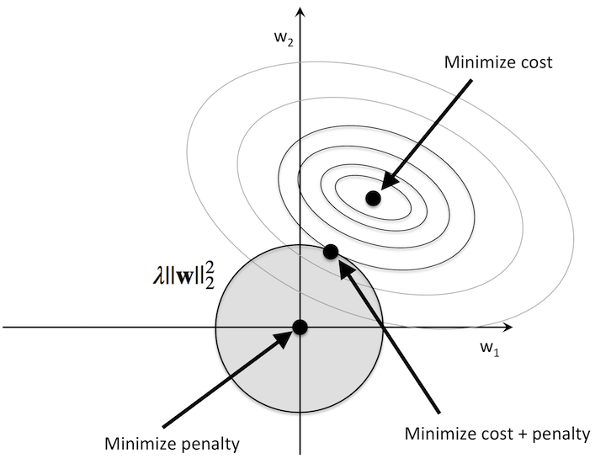
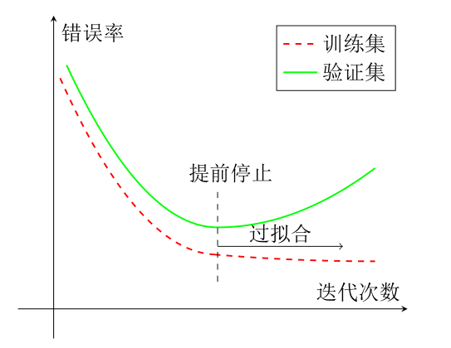
Regularization (正则化)
All damage optimization methods are regularization.
Add optimization constraints
Interfere optimization process
L1/L2 constraints, Data enhancement
Weight attenuation, SGD, Early Stop

Slide 19
2.1 Linear Regression

Slide 20
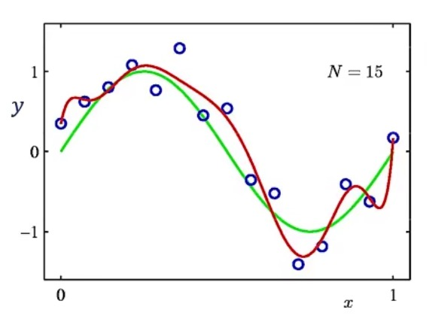
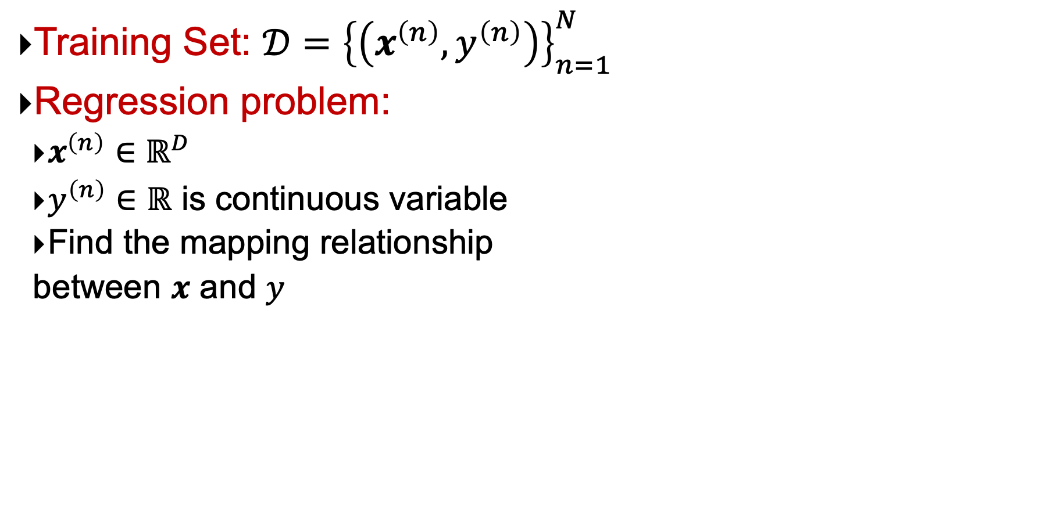

Regression (回归)
Training Set: $𝒟={\left\{\left(x^{\left(n\right)},y^{\left(n\right)}\right)\right\}}_{n=1}^{N}$
Regression problem:
$x^{\left(n\right)}∈ℝ^{D}$
$y^{\left(n\right)}∈$ $ℝ$ is continuous variable
Find the mapping relationship
between $x$ and $y$
$$y=f(x;θ)$$

Slide 21
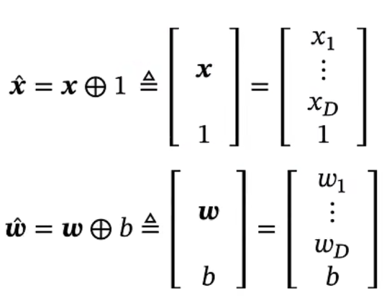
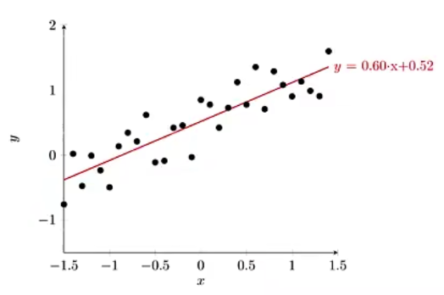
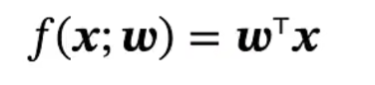
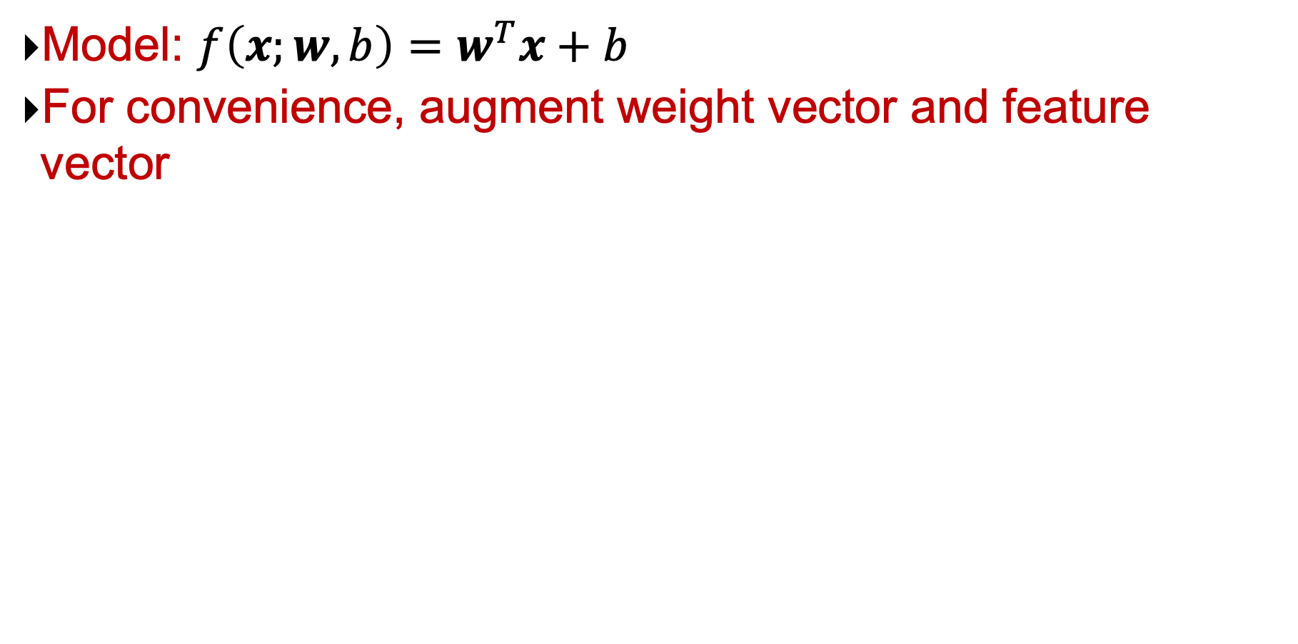
Linear Regression (线性回归)
Model: $f\left(x;w, b\right)=w^{T}x+b$
For convenience, augment weight vector and feature vector

Slide 22
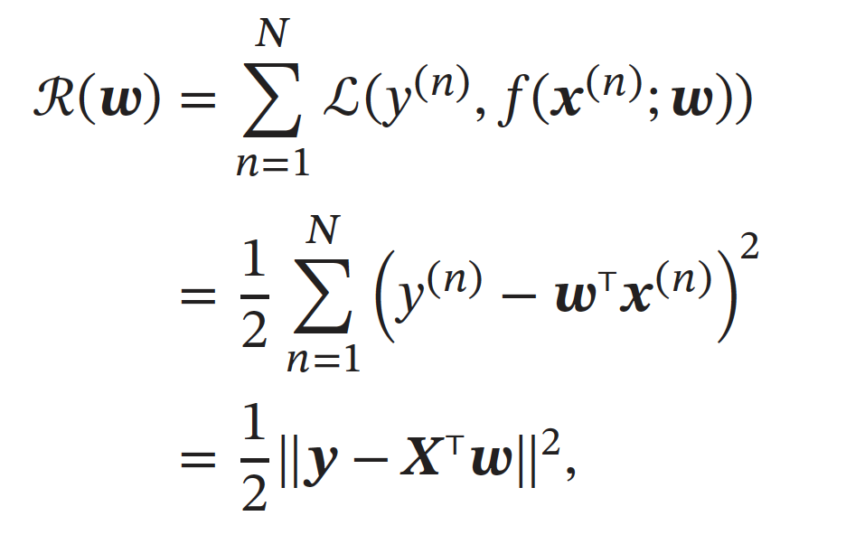
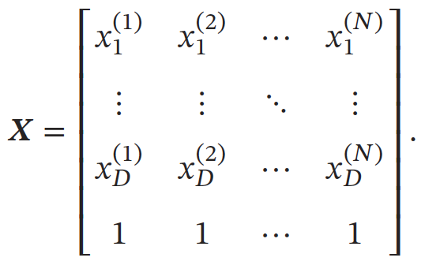
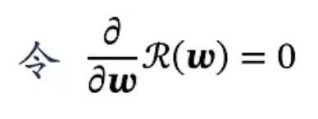
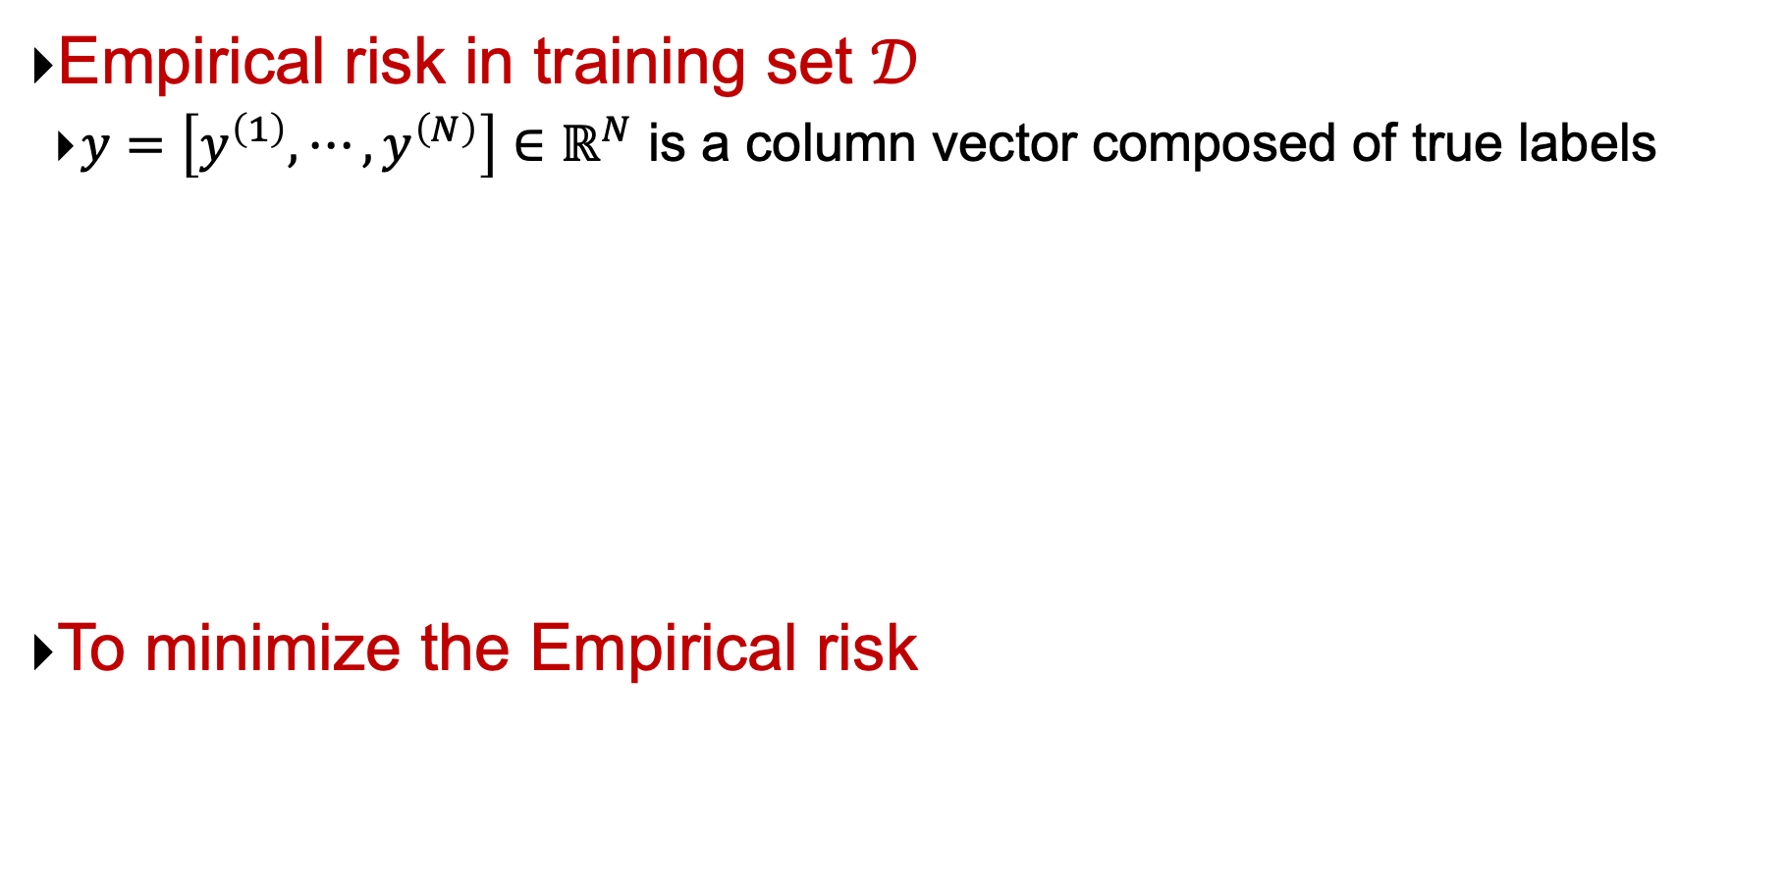
Empirical Risk Minimization (ERM）
Empirical risk in training set $𝒟$
$y=\left[y^{\left(1\right)},⋯,y^{\left(N\right)}\right]∈ℝ^{N}$ is a column vector composed of true labels
To minimize the Empirical risk

Slide 23
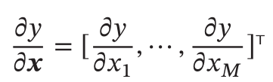
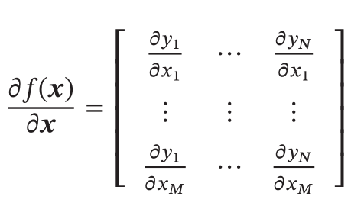
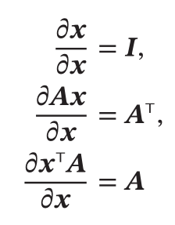
Matrix Calculus
Partial derivative of scalar w.r.t. vector
P.d. of vector w.r.t. vector
Vector function:

Slide 24
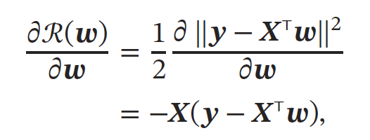
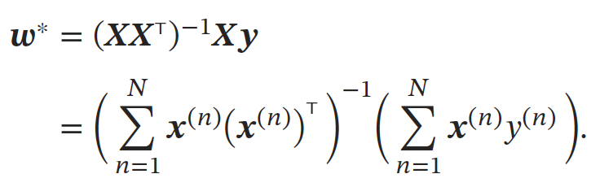
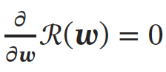
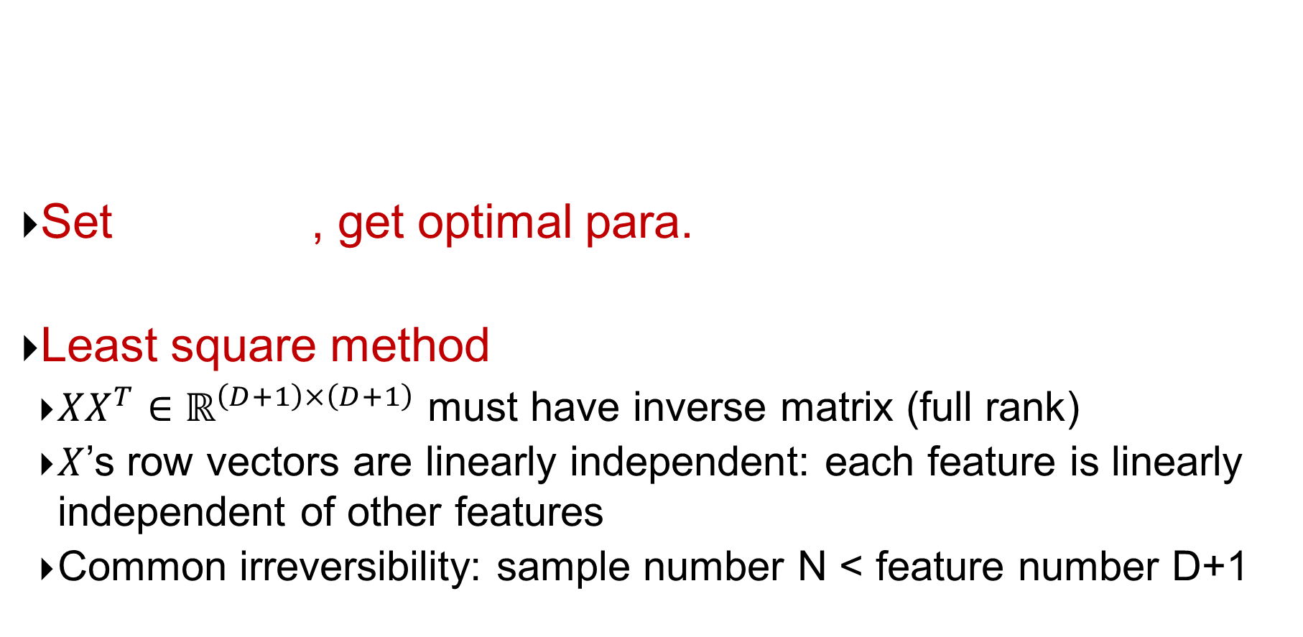
经验风险最小化
Set , get optimal para.
Least square method
$XX^{T}∈ℝ^{\left(D+1\right)×\left(D+1\right)}$ must have inverse matrix (full rank)
$X$’s row vectors are linearly independent: each feature is linearly independent of other features
Common irreversibility: sample number N < feature number D+1

Slide 25
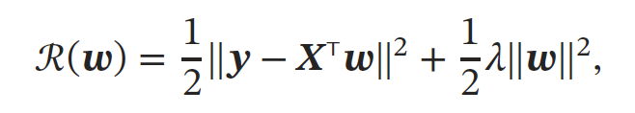
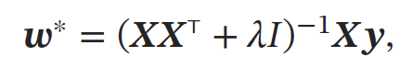
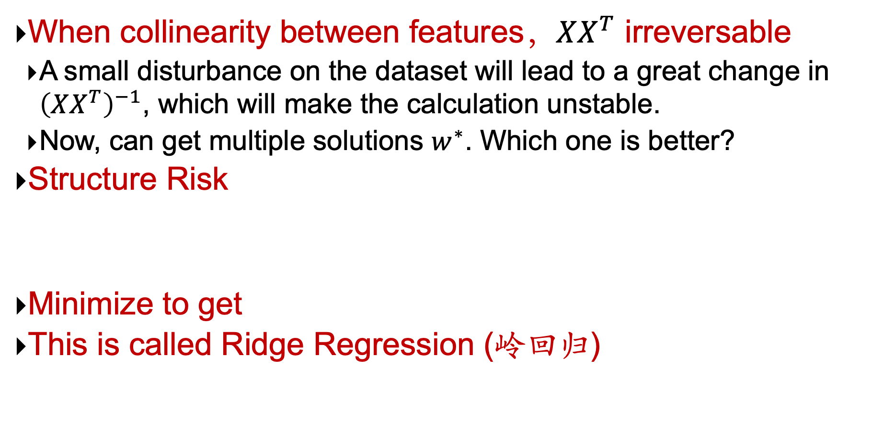
Structure Risk Minimization (结构风险最小化, SRM）
When collinearity between features，$XX^{T}$ irreversable
A small disturbance on the dataset will lead to a great change in ${\left(XX^{T}\right)}^{−1}$, which will make the calculation unstable.
Now, can get multiple solutions $w^{∗}$. Which one is better?
Structure Risk
Minimize to get
This is called Ridge Regression (岭回归)

Slide 26
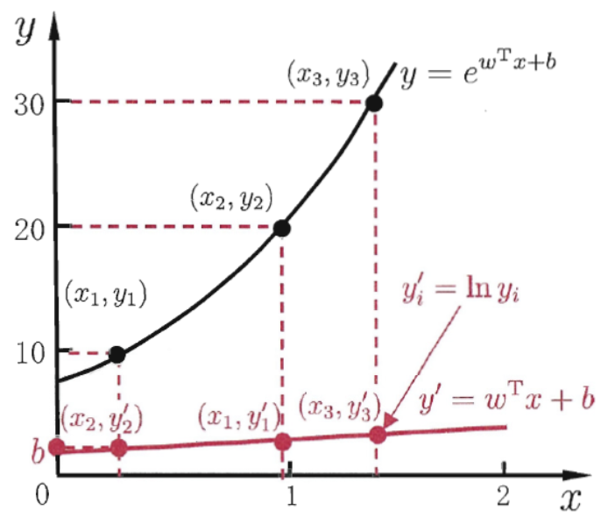
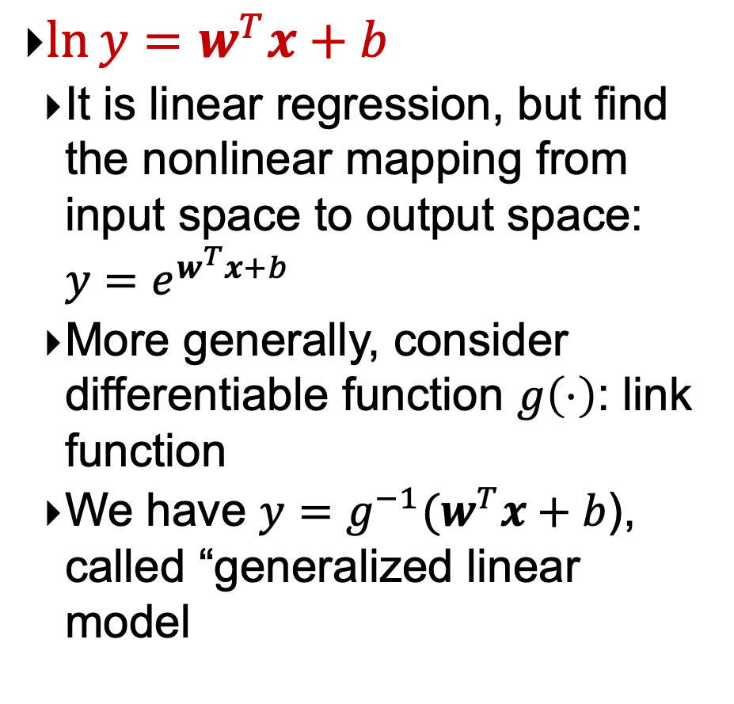
Variant: Log-linear regression
$\ln{y}=w^{T}x+b$
It is linear regression, but find the nonlinear mapping from input space to output space: $y=e^{w^{T}x+b}$
More generally, consider differentiable function $g\left(⋅\right)$: link function
We have $y=g^{−1}(w^{T}x+b$), called “generalized linear model

Slide 27


Curve Fitting (曲线拟合)
Given the Training Set: $𝒟={\left\{\left(x^{\left(n\right)},y^{\left(n\right)}\right)\right\}}_{n=1}^{N}$, where $x^{\left(n\right)}∈ℝ^{D}$ and
$y^{\left(n\right)}∈$ $ℝ$ are continuous variables, to find the mapping relationship between $x$ and $y$: $y=f\left(x;w\right)=w^{T}φ(x)+b$

Slide 28


Polynomial Curve Fitting (多项式曲线拟合)
Model definition:
$$f\left(x;w\right)=w_{0}+w_{1}x+w_{2}x^{2}+⋯+w_{M}x^{M}$$

Slide 29


Loss function
Sum-of-Squares (平方误差)
$$R\left(w\right)=\frac{1}{2}\sum_{n=1}^{N}{{\left(y^{\left(n\right)}−w^{T}φ\left(x^{\left(n\right)}\right)\right)}^{2}}$$
Minimize empirical risk
Solution process is similar
to linear regression
M is a hyperparameter

Slide 30

How to Choose Polynomial Degree?
模型选择问题
A model selection problem
M = 9 → E(w) = 0: This is overfitting

Slide 31

How to Choose Polynomial Degree?
As order of polynomial M increases, so do coefficient magnitudes!
Punish large coefficients.
Notes:
当多项式阶数 $M$ 提升时，最小二乘会倾向于用非常大的权重去“穿过”训练点，导致你在图中看到的高频振荡与巨大的 $w_{j}$ 值。

Slide 32


Control Overfitting: Regularization
Punish large coefficients:
$λ$ is regularization coefficient (正则化系数)
Regularization term

Slide 33

Control Overfitting: Regularization

Slide 34

Control Overfitting: Increase training samples

Slide 35
2.2 Probability Distribution

Slide 36




Some Basic Concepts about Probability
Probability
Probability of a random event is a real number between 0 and 1
Random variable (r.v.)
Real single-valued functions of various results of random tests
For example, if a dice is randomly thrown, the number of points obtained can be regarded as a r.v $X$, and its value is {1,2,3,4,5,6}
Probability Distribution
Probability that a r.v. $X$ takes every possible value.
Satisfying:
Notes:
1950年图灵测试：“一个人在不接触对方的情况下，通过一种特殊的方式，和对方进行一系列的问答。如果在相当长时间内，他无法根据这些问题判断对方是人还是计算机，那么就可以认为这个计算机是智能的”。

Slide 37

Random Variable
Discrete random variable
Bernoulli Distribution
In a test, event A happens with probability $μ$, does not happen with probability $1−μ$
If using r.v. X to indicate the number of occurrences of event A, then X can be 0 or 1, its distribution is
$$p\left(x\right)=μ^{x}{\left(1−μ\right)}^{1−x}$$

Slide 38

Random Variable
Discrete random variable
Binomial Distribution
In the n times Bernoulli distribution, if r.v. X represents the number of occurrences of event A, the value of X is {0,…,n}, and its corresponding distribution
$$p\left(X=k\right)=\left(\begin{matrix}n \\ k\end{matrix}\right)μ^{k}{\left(1−μ\right)}^{n−k}, k=1,⋯,n$$
Binomial coefficient represents the total number of combinations of elements taken out of elements regardless of their order.

Slide 39



Random Variable
Continuous random variable
Probability distribution can be described by Probability Density function (PDF) $f\left(x\right)$:
$$\int_{−∞}^{+∞}{f\left(x\right)}dx=1$$
Gaussian Distribution:

Slide 40


Random Variable
Continuous random variable
Cumulative Distribution Function (CDF) is the probability of the value of r.v. $X$ less than or equal to $x$:
$$F\left(x\right)=P(X≤x)$$
For continuous r.v., we have
$$F\left(x\right)=\int_{−∞}^{x}{f\left(t\right)}dt$$

Slide 41

Random Vector
A vector consisting of a set of random variables
Multivariate distribution
Discrete r.v.: Joint Probability Distribution
$$P\left(X_{1}=x_{1},X_{2}=x_{2},⋯,X_{n}=x_{n}\right)=p\left(x_{1},x_{2},⋯,x_{n}\right)$$
Continuous r.v.: Joint probability density $f(x_{1},x_{2},⋯,x_{n}$)
Joint Distribution Function:
$$F\left(x_{1},x_{2},⋯,x_{n}\right)=P\left(X_{1}≤x_{1},X_{2}≤x_{2},⋯,X_{n}≤x_{n}\right) \\ =\int_{−∞}^{x_{1}}{\int_{−∞}^{x_{2}}{⋯\int_{−∞}^{x_{n}}{f}\left(t_{1},t_{2},⋯,t_{n}\right)dt_{1}dt_{2}⋯dt_{n}}}$$

Slide 42

Marginal Distribution
Marginal probability mass function
Given a known joint distribution of two discrete r.v. X and Y, the marginal distribution of either variable – X for example – is the probability distribution of X when the values of Y are not taken into consideration.
$$p_{X}\left(x_{i}\right)=\sum_{j}{p\left(x_{i},y_{j}\right)} or p_{Y}\left(y_{j}\right)=\sum_{i}{p\left(x_{i},y_{j}\right)}$$
Marginal probability density function
$$f_{X}\left(x\right)=\int_{−∞}^{+∞}{f\left(x,y\right)dy} or f_{Y}\left(y\right)=\int_{−∞}^{+∞}{f\left(x,y\right)dx}$$

Slide 43


Conditional Probability
For a discrete random vector $(X,Y)$, when $X=x$ is known, the conditional probability of r.v. $Y=y$ is
$$p\left(y | x\right)=P\left(Y=y | X=x\right)=\frac{p(x,y)}{p(x)}$$

Slide 44

An example of conditional probability

Slide 45



Sampling
Sampling: given a probability distribution p(x), generate samples that meet the conditions
$$x^{(1)},x^{(2)},⋯,x^{\left(N\right)}∼p(x)$$

Slide 46


How to conduct random sampling?
Direct sampling
Uniform distribution: Uniform[0.1)
Discrete distribution

Slide 47


How to conduct random sampling?
Other continuous distribution
For example, Inverse Transform Sampling (逆变换采样)

Slide 48

Expectation
Expectation: the average of random variable
For discrete r.v. X:
$$𝔼\left[X\right]=\sum_{n=1}^{N}{x_{n}p\left(x_{n}\right)}$$
For continuous r.v. X:
$$𝔼\left[X\right]=\int_{−∞}^{+∞}{xf\left(x\right)d(x)}$$

Slide 49

Law of Large Numbers
When the number of samples is large, the sample mean and the real mean (expectation) are fully close.
Given N independently and identically distributed (I.I.D.) samples
$$x^{(1)},x^{(2)},⋯,x^{\left(N\right)}∼p(x)$$
Its mean value converges to the expected value:
$${\overline{x}}_{N}=\frac{1}{N}\left(x^{\left(1\right)}+x^{\left(2\right)}+⋯+x^{\left(N\right)}\right)→𝔼\left[X\right] for N→∞$$

Slide 50
2.3 Naïve Bayes Classification

Slide 51

Bayesian classification
Probabilistic view: Supervised learning can naturally be studied from a probabilistic point of view.
Let $A=\{A_{1},A_{2},⋯\}$ be attribute set with discrete values. Class is $C$.
Given a test example $d$ with observed attribute values $a_{1},a_{2},⋯$.
Classification is basically to compute the following posteriori probability. The prediction is the class $c_{j}$ such that
$$\operatorname{Pr}{(C=c_{j}|A_{1}=a_{1},⋯,A_{\left|A\right|}=a_{\left|A\right|})}$$
is maximized.

Slide 52


Applying Bayes’ rule
$$\operatorname{Pr}{(}C=c_{j}|A_{1}=a_{1},...,A_{\left|A\right|}=a_{|A|})$$
$$=\frac{\operatorname{Pr}{(}A_{1}=a_{1},...,A_{|A|}=a_{|A|}|C=c_{j})\operatorname{Pr}{(}C=c_{j})}{\operatorname{Pr}{(}A_{1}=a_{1},...,A_{|A|}=a_{|A|})}$$
$$=\frac{\operatorname{Pr}{(}A_{1}=a_{1},...,A_{|A|}=a_{|A|}|C=c_{j})\operatorname{Pr}{(}C=c_{j})}{\sum_{r=1}^{|C|}{\operatorname{Pr}{(}A_{1}=a_{1},...,A_{|A|}=a_{|A|}|C=c_{r})\operatorname{Pr}{(}C=c_{r})}}$$
Pr(C=c_{j}) is the class prior probability: easy to estimate from the training data.

Slide 53

Computing probabilities
The denominator $\operatorname{Pr}{(}A_{1}=a_{1},...,A_{|A|}=a_{|A|})$ is irrelevant for decision making since it is the same for every class.
We only need $\operatorname{Pr}{(}A_{1}=a_{1},...,A_{|A|}=a_{|A|}|C=c_{j})$, which can be written as $\operatorname{Pr}{(}A_{1}=a_{1}|A_{2}=a_{2},⋯,A_{|A|}=a_{|A|},C=c_{j})⋅\operatorname{Pr}{(}A_{2}=a_{2},...,A_{|A|}=a_{|A|}|C=c_{j})$
Recursively, the second factor above can be written in the same way, and so on.
Now an assumption is needed.

Slide 54

Conditional Independence Assumption
All attributes are conditionally independent given the class $C=c_{j}$
Formally, we assume
$$Pr\left(A_{1}=a_{1}|A_{2}=a_{2},⋯,A_{|A|}=a_{|A|},C=c_{j}\right)=Pr\left(A_{1}=a_{1} | C=c_{j}\right)$$
and so on for $A_{2}$ through $A_{|A|}$.
Thus, we have
$$\operatorname{Pr}{(}A_{1}=a_{1},...,A_{|A|}=a_{|A|}\left|C=c_{j}\right)=\prod_{i=1}^{|A|}{Pr\left(A_{i}=a_{i} | C=c_{j}\right)}$$

Slide 55

Final Naïve Bayesian Classifier
$$\operatorname{Pr}{(}C=c_{j}|A_{1}=a_{1},...,A_{|A|}=a_{|A|}) \\ =\frac{\operatorname{Pr}{(}C=c_{j})\prod_{i=1}^{|A|}{\operatorname{Pr}{(}A_{i}=a_{i}|C=c_{j})}}{\sum_{r=1}^{|C|}{\operatorname{Pr}{(}C=c_{r})\prod_{i=1}^{|A|}{\operatorname{Pr}{(}A_{i}=a_{i}|C=c_{r})}}}$$
We are done!
How do we estimate P(A_{i} = a_{i}| C=c_{j})? Easy!.

Slide 56

Classify a test instance
If we only need a decision on the most probable class for the test instance, we only need the numerator as its denominator is the same for every class.
Thus, given a test example, we compute the following to decide the most probable class for the test instance
$$c=\underset{c_{j}}{argmax}\operatorname{Pr}{(}c_{j})\prod_{i=1}^{|A|}{\operatorname{Pr}{(}A_{i}=a_{i}\left|C=c_{j}\right)}$$

Slide 57


An Example
Compute all probabilities required for classification

Slide 58

An Example (cont …)
For class $C=t$, we have
$$\operatorname{Pr}{(}C=t)\prod_{j=1}^{2}{\operatorname{Pr}{(}A_{j}=a_{j}\left|C=t\right)} =\frac{1}{2}×\frac{2}{5}×\frac{2}{5}=\frac{2}{25}$$
For class $C=f$, we have
$$\operatorname{Pr}{(}C=f)\prod_{j=1}^{2}{\operatorname{Pr}{(}A_{j}=a_{j}\left|C=f\right)} =\frac{1}{2}×\frac{1}{5}×\frac{2}{5}=\frac{1}{25}$$
$C=t$ is more probable, thus $t$ is the final class

Slide 59

Additional Issues
Numeric attributes: Naïve Bayesian learning assumes that all attributes are categorical. Numeric attributes need to be discretized.
Zero counts: An particular attribute value never occurs together with a class in training set. We need smoothing.
$$\operatorname{Pr}{(}A_{i}=a_{i}\left|C=c_{j}\right)=\frac{n_{ij}+λ}{n_{j}+λS_{i}} \\ \operatorname{Pr}{(}C=c_{j})=\frac{n_{j}+λ}{N+λK}$$
Missing values: Ignored
Notes:
平滑操作：
可能出现所要估计的概率为0的情况。这时会影响到后验概率的计算结果，使分类产生偏差。
\lambda>=0, \lambda=0时就是极大似然估计，\lambda=1称为Laplacian smoothing.
S_i：属性A_i可能取值的数量；K为Label可能取值的数量。
$∑\operatorname{Pr}{(}A_{i}=a_{i}\left|C=c_{j}\right)=1$

Slide 60
On naïve Bayesian classifier
Advantages:
Easy to implement
Very efficient
Good results obtained in many applications
Disadvantages
Assumption: class conditional independence, therefore loss of accuracy when the assumption is seriously violated (those highly correlated data sets)

Slide 61
Naïve Bayes on Text Classification
I love this movie! It's sweet, but with satirical humor. The dialogue is great and the adventure scenes are fun… It manages to be whimsical and romantic while laughing at the conventions of the fairy tale genre. I would recommend it to just about anyone. I've seen it several times, and I'm always happy to see it again whenever I have a friend who hasn't seen it yet.
γ(
)=c

Slide 62
The bag of words representation
I love this movie! It's sweet, but with satirical humor. The dialogue is great and the adventure scenes are fun… It manages to be whimsical and romantic while laughing at the conventions of the fairy tale genre. I would recommend it to just about anyone. I've seen it several times, and I'm always happy to see it again whenever I have a friend who hasn't seen it yet.
γ(
)=c

Slide 63
The bag of words representation: using a subset of words
x love xxxxxxxxxxxxxxxx sweet xxxxxxx satirical xxxxxxxxxx xxxxxxxxxxx great xxxxxxx xxxxxxxxxxxxxxxxxxx fun xxxx xxxxxxxxxxxxx whimsical xxxx romantic xxxx laughing xxxxxxxxxxxxxxxxxxxxxxxxxxxxxxxxxxxxxxxxxxxx recommend xxxxx xxxxxxxxxxxxxxxxxxxxxxxxxxxxxxxx several xxxxxxxxxxxxxxxxx xxxxx happy xxxxxxxxx again xxxxxxxxxxxxxxxxxxxxxxxxxxxxxxxxxxxxxxxxxxxxxxx
γ(
)=c

Slide 64
The bag of words representation
great | 2
love | 2
recommend | 1
laugh | 1
happy | 1
... | ...
γ(
)=c

Slide 65
Bayes’ Rule Applied to Documents and Classes
For a document d and a class c
MAP is “maximum a posteriori” = most likely class
Bayes Rule
Dropping the denominator

Slide 66

A General Workflow of Text Classification

Slide 67

A Simple Example

Slide 68

A Simple Example

Slide 69
A Simple Example
We can predict the class of last data by using Naive Bayes by considering the probability of important words,
Important words for com.graphics from the data can be considered as:{Nvidia, GPU, AMD, GTX 1050}
All words will have feature vectors of theirs representing their number of occurrences in each record,
Nvidia -> [1; 1; 0; 0] and so on.
P(computer graphics | GPU) = P(GPU | computer graphics) * (P(computer graphics) / P(GPU))

Slide 70
A Simple Example
P(computer graphics) = Number of records having class as computer graphics / Number of total records = 3/4 = 0.75
P(GPU) = Number of records having GPU / Total number of records = 3/4 = 0.75
P(GPU | computer graphics) = Number of records having computer graphics with GPU in it / Total number of computer graphics' records = 2 /3 = 0.66
P(computer graphics | GPU) = 0.66 * (0.75/0.75) = 0.66
This is greater than 0.5 so we can predict that this text data will be belonging to computer graphics.
Here, we have considered only one word GPU that is important in our test data but in real data we'll consider feature vectors of all words and then compute the probability for the class based on the occurrences of all the non primitive words.
The main advantage is that you can get really good results when data available is not much and computational resources are scarce.

Slide 71
2.4 Evaluation of Classifiers

Slide 72

Evaluating classification methods
Predictive accuracy:
$$Accuracy=\frac{Number of correct classifications}{Total Number of test cases}$$
Efficiency
time to construct the model
time to use the model
Robustness: handling noise and missing values
Scalability: efficiency in disk-resident databases
Interpretability: understandable and insight provided by the model
Compactness of the model: size of the tree, or the number of rules.

Slide 73

Evaluation methods
Holdout set: The available data set $D$ is divided into two disjoint subsets,
the training set $D_{train}$ (for learning a model)
the test set $D_{test}$ (for testing the model)
Important: training set should not be used in testing and the test set should not be used in learning.
Unseen test set provides a unbiased estimate of accuracy.
The test set is also called the holdout set. (the examples in the original data set $D$ are all labeled with classes.)
This method is mainly used when the data set $D$ is large.

Slide 74

Evaluation methods (cont…)
n-fold cross-validation: The available data is partitioned into $n$ equal-size disjoint subsets.
Use each subset as the test set and combine the rest $n−1$ subsets as the training set to learn a classifier.
The procedure is run $n$ times, which give n accuracies.
The final estimated accuracy of learning is the average of the $n$ accuracies.
10-fold and 5-fold cross-validations are commonly used.
This method is used when the available data is not large.

Slide 75

Evaluation methods (cont…)

Slide 76
Evaluation methods (cont…)
Leave-one-out cross-validation: This method is used when the data set is very small.
It is a special case of cross-validation
Each fold of the cross validation has only a single test example and all the rest of the data is used in training.
If the original data has m examples, this is m-fold cross-validation

Slide 77
Evaluation methods (cont…)
Validation set: the available data is divided into three subsets,
A training set,
A validation set and
A test set.
A validation set is used frequently for estimating parameters in learning algorithms.
In such cases, the values that give the best accuracy on the validation set are used as the final parameter values.
Cross-validation can be used for parameter estimating as well.

Slide 78
Early Stop
Validation Dataset to test whether the parameters of each iteration are optimal on the validation dataset. If the error rate on the verification set no longer decreases, the iteration is stopped.

Slide 79
Classification measures
Accuracy is only one measure (error = 1-accuracy).
Accuracy is not suitable in some applications.
In text mining, we may only be interested in the documents of a particular topic, which are only a small portion of a big document collection.
In classification involving skewed or highly imbalanced data, e.g., network intrusion and financial fraud detections, we are interested only in the minority class.
High accuracy does not mean any intrusion is detected.
E.g., 1% intrusion. Achieve 99% accuracy by doing nothing.
The class of interest is commonly called the positive class, and the rest negative classes.

Slide 80

Precision and recall measures
Used in information retrieval and text classification.
We use a confusion matrix to introduce them.
Notes:
TP+FP+TN+FN = 样本总数
Confusion Matrix
re

Slide 81


Precision and recall measures (cont…)
$$p=\frac{TP}{TP+FP}\text{. } r=\frac{TP}{TP+FN}.$$
Precision p is the number of correctly classified positive examples divided by the total number of examples that are classified as positive.
Recall r is the number of correctly classified positive examples divided by the total number of actual positive examples in the test set.

Slide 82

An example
This confusion matrix gives
precision p = 100% and
recall r = 1%
because we only classified one positive example correctly and no negative examples wrongly.
Note: precision and recall only measure classification on the positive class.

Slide 83

P-R Curve
According to the prediction results of the learner, the higher the ranking, the more likely it is to be a positive example.
If the samples are taken as positive examples one by one in this order, a set of precision and recall can be achieved.
Question?
Which one is better?
Notes:
根据学习器的预测结果进行排序，排在越前面认为越有可能是正例子。
按此顺序逐个把样本作为正例进行预测，则可达到一组查准率与查全

Slide 84


F1-value (also called F1-score)
It is hard to compare two classifiers using two measures. F₁ score combines precision and recall into one measure
The harmonic mean of two numbers tends to be closer to the smaller of the two.
For F₁-value to be large, both p and r much be large.

Slide 85
Which one should we use, P or R?
Classification: generate a real value or probability prediction for the test sample, and then compare this prediction value with a classification threshold. If it is greater than the threshold, it will be classified as positive, otherwise negative.
Equivalent to sorting, "most likely" is the positive case at the front, and "least likely" is the positive case at the back. The classification process is equivalent to dividing the sample into two parts by a certain "cut-off point" in this sorting, the former part is judged as positive cases, and the latter part is judged as negative cases.
If more attention is paid to P, the front position will be truncated, such as product recommendation.
If more attention is paid to R, the back position will be truncated, such as fugitive search.
Notes:
如果更重视P，则靠前的位置进行截断，如商品推荐。
如过更重视R，则靠后的位置进行截断，如逃犯检索。

Slide 86


Receive operating characteristics curve
It is commonly called the ROC curve.
It is a plot of the true positive rate (TPR) against the false positive rate (FPR).
True positive rate:
False positive rate:

Slide 87


Sensitivity and Specificity
In statistics, there are two other evaluation measures:
Sensitivity: Same as TPR
Specificity: Also called True Negative Rate (TNR)
Then we have
Notes:
Specificity：特异性

Slide 88

Example ROC curves
Notes:
我们根据学习器的预测结果对样例进行排序,按此顺序逐个把样本作为正例进行预测，每次计算出两个重要量的值,分别以它们为横、纵坐标作图，就得到了“ROC 曲线”.
对角线对应于“随机猜测”模型,而点(0,1)则对应于将所有正例排在所有反例之前的“理想模型”.

Slide 89

Area under the curve (AUC)
Which classifier is better, $C_{1}$ or $C_{2}$?
It depends on which region you talk about.
Can we have one measure?
Yes, we compute the area under the curve (AUC)
If AUC for $C_{i}$ is greater than that of $C_{j}$, it is said that $C_{i}$ is better than $C_{j}$.
If a classifier is perfect, its AUC value is 1
If a classifier makes all random guesses, its AUC value is 0.5.

Slide 90

Drawing an ROC curve

Slide 91

Drawing an ROC curve

Slide 92
Another evaluation method: Scoring and ranking
Scoring is related to classification.
We are interested in a single class (positive class), e.g., buyers class in a marketing database.
Instead of assigning each test instance a definite class, scoring assigns a probability estimate (PE) to indicate the likelihood that the example belongs to the positive class.

Slide 93
Ranking and lift analysis
After each example is given a PE score, we can rank all examples according to their PEs.
We then divide the data into n (say 10) bins. A lift curve can be drawn according how many positive examples are in each bin. This is called lift analysis.
Classification systems can be used for scoring. Need to produce a probability estimate.
E.g., in decision trees, we can use the confidence value at each leaf node as the score.

Slide 94
An example
We want to send promotion materials to potential customers to sell a watch.
Each package cost $0.50 to send (material and postage).
If a watch is sold, we make $5 profit.
Suppose we have a large amount of past data for building a predictive/classification model. We also have a large list of potential customers.
How many packages should we send and who should we send to?

Slide 95
An example
Assume that the test set has 10000 instances. Out of this, 500 are positive cases.
After the classifier is built, we score each test instance. We then rank the test set, and divide the ranked test set into 10 bins.
Each bin has 1000 test instances.
Bin 1 has 210 actual positive instances
Bin 2 has 120 actual positive instances
Bin 3 has 60 actual positive instances
…
Bin 10 has 5 actual positive instances

Slide 96
Lift Curve
Bin 1 2 3 4 5 6 7 8 9 10

Slide 97
2.5 Linear Regression from a Probability Perspective

Slide 98


Linear regression from a probability perspective
Assuming label $y$ is a r.v., which follows the Gaussian distribution with the average $w^{T}x$ and variance $σ^{2}$
Notes:
y=f(x;w)+epsilon, epsilon服从N(0,sigma^2)

Slide 99

Likelihood Function (似然函数)
The likelihood function is a function of the parameter $w$ about the statistical model $p(x;w)$
Probability $p(x;w)$ describes the distribution of the random variable $x$ when the parameter $w$ is fixed.
Likelihood $p(x;w)$describes the influence of different parameters $w$ on the distribution of a known random variable $x$.

Slide 100

Maximum Likelihood Estimation (MLE)
Assume $X_{1},X_{2},⋯,X_{n}$ are samples from $X$, the probability of the observed samples occurrence is $\prod_{i=1}^{n}{p(x_{i};w)}$.
Likelihood function:
$$L\left(w\right)=L\left(x_{1},x_{2},⋯,x_{n};w\right)=\prod_{i=1}^{n}{p(x_{i};w)}$$
Maximize the likelihood function to get $\hat{w}$:
$$\hat{w}={argmax}_{w}L\left(x_{1},x_{2},⋯,x_{n};w\right)$$
where $\hat{w}(x_{1},x_{2},⋯,x_{n}$) is maximum likelihood estimation and $\hat{w}(X_{1},X_{2},⋯,X_{n}$) is maximum likelihood statistic.
Log Likelihood Equation:
$${dL(w)}/{dw}=0→{dlogL\left(w\right)}/{dw}=0$$

Slide 101





Likelihood Function in Linear Regression
Likelihood function of parameter $w$ in training set $D$
MLE finds a set of parameters $w$ such that the likelihood function $p(y|X;w,σ)$

Slide 102

Bayesian Perspective
Maximum Likelihood:
When the training data is relatively small, overfitting will occur, resulting in inaccurate parameter estimation
Add prior (先验) knowledge to the parameters
Bayesian Learning:
Consider the parameter $w$ as a random variable
Objective: Given a set of observation data $X$, find the distribution $p(w|X)$ of parameter $w$
$p(w|X)$ is also called posterior distribution (后验分布)

Slide 103


Basic Idea of Probability
Bayesian rule
The relationship between $p\left(y | x\right)$ and $p(x|y)$: $p\left(y | x\right)=\frac{p\left(x | y\right)p(y)}{p\left(x\right)}$
Posterior, Likelihood, and prior
$$p(w|x)∝p\left(x | w\right)p(w)$$
Posterior $∝$ Likelihood$×$Prior

Slide 104

Bayesian Estimation
Linear regression adopting Bayesian estimation is called Bayesian Linear Regression (贝叶斯线性回归)

Slide 105

Maximum A Posteriori Estimation (MAP)
Bayesian estimation is an interval estimation of parameters, that is, the distribution of parameters in an interval.
If you want to get an optimal parameter value, you can use the maximum a posteriori estimation (MAP).
argmax

Slide 106


Conclusion
 | Without prior | With prior
square error | Empirical risk minimization | Structural risk minimization
probability | MLE | MAP
Notes:
最大似然估计：频率学派
贝叶斯估计：贝叶斯学派

Slide 107
2.6 Bias-Variance Decomposition

Slide 108
How to select a suitable model?
Model Selection
Models with strong fitting ability are generally more complex and easy to overfitting.
If the complexity of the model is limited and the fitting ability is reduced, it may be underfitted.
How to select a model?
The more complex the model, the lower the training error.
Model cannot be selected according to the lowest training error.
When selecting a model, the test set is not visible.

Slide 109



Bias-Variance Decomposition
Expected risk：
$$ℛ\left(f\right)=𝔼_{\left(x,y\right)∼p_{r}(x,y)}\left[{\left(y−f\left(x\right)\right)}^{2}\right]$$
The best model that ML algorithm can learn：
$$f^{∗}\left(x\right)=𝔼_{y∼p_{r}(y|x)}[y]$$
Expected risk can decomposed into
真实目标：当前模型与最优模型之间的差距

Slide 110


Bias-Variance Decomposition
Actually training a model, different training sets get different models.
The ability of a ML algorithm (including model and optimization algorithm) can be evaluated by the average performance of models on different training sets.
$f_{𝒟}(x)$ is the model learned from training set $𝒟$.
For a single samples:
Notes:
偏差：一个模型在不同训练集上的平均性能和最优模型的差异，用来衡量拟合能力。
方差：一个模型在不同训练集上的差异，用来衡量一个模型是否过拟合。

Slide 111





Bias-Variance Decomposition
Expected error
Expected error is decomposed into

Slide 112


Model Selection: Deviation and Variance
Minimizing expected risk is equivalent to minimizing the sum of deviation and variance.
Ensemble model: an effective method to reduce variance
Notes:
如果在验证集上的错误率不再下降，就停止迭代。

Slide 113

Common Theorems
No Free Lunch Theorem (没有免费午餐定理)
For the iterative optimization algorithm, there is no algorithm that is effective for all problems (in a limited search space). If an algorithm is effective for some problems, it must be worse than the pure random search algorithm for others.

Slide 114

Common Theorems
Ugly Duckling Theorem (丑小鸭定理)
The difference between an ugly duckling and a white swan is as great as that between two white swans.
Notes:
丑小鸭与白天鹅之间的区别和两只白天鹅之间的区别一样大.
因为世界上不存在相似性的客观标准，一切相似性的标准都是主观的．如果从体型大小或外貌的角度来看，丑小鸭和白天鹅的区别大于两只白天鹅的区别；但是如果从基因的角 度来看，丑小鸭与它父母的差别要小于它父母和其他白天鹅之间的差别．

Slide 115

Common Theorems
Occam's Razor (奥卡姆剃刀原理)
If it is not necessary, do not add entities.
Notes:
如无必要，勿增实体 如果简单模型能解决，不要用复杂模型。

Slide 116
Inductive Bias (归纳偏置)
Many learning algorithms often make some assumptions about learning problems, which are called inductive bias.
In the nearest neighbor (KNN) classifier, we will assume that most samples in a small local area belong to the same category in the feature space.
In Naïve Bayes classifier, we will assume that the conditional probability of each feature is independent of each other.
Inductive bias is often called Prior in Bayesian learning.

Slide 117


PAC Learning
PAC: Probably Approximately Correct
According to the law of large numbers, when the training set size |D| tends to infinity, the generalization error tends to zero, the empirical risk tends to the expected risk.
PAC Learning:
Approximate correctness，0 < ϵ <0.5
probably，0 < δ <0.5

Slide 118


Sample Complexity
For a fixed ϵ, δ, the sample complexity can be calculated in turn as follows
where |$ℱ$| is the size of the hypothetical space, which can be measured by Rademacher complexity or VC dimension.
PAC learning theory can help to analyze under what conditions a ML method can learn an approximately correct classifier.
If we hope that the larger the hypothesis space of the model is, the smaller the generalization error is, and the more samples it needs.
Notes:
拉特马赫(Rademacher)
模型属于由输入空间到输出空间的映射的集合，这个集合就是假设空间(hypothesis space)。假设空间的确定意味着学习范围的确定。

